Slide 1
Document design and purpose, not mechanics
Fluri Wieland, Pascal Neiger

Slide 2
Document interfaces and reasons, not implementations
Do’s
Document inputs and what the function does:
def zStandardization (input, m, std)
#Function standardizes input into z-#distribution by means of m and #std.
#input can be a vector or matrix of #doubles
#m is the mean of your distribution. If not #set, m is calculated depending on your #data.
#std is the standard deviation of your #distribution. If not set, std is calculated #depending on your data
Don’t’s
Don’t document single lines of code like:
meanInput = np.mean(input) #calculate #mean of input
zDiff = input – m #calculates difference for #each data point and m
zVal = zDiff / std #calculates z-Values

Slide 3
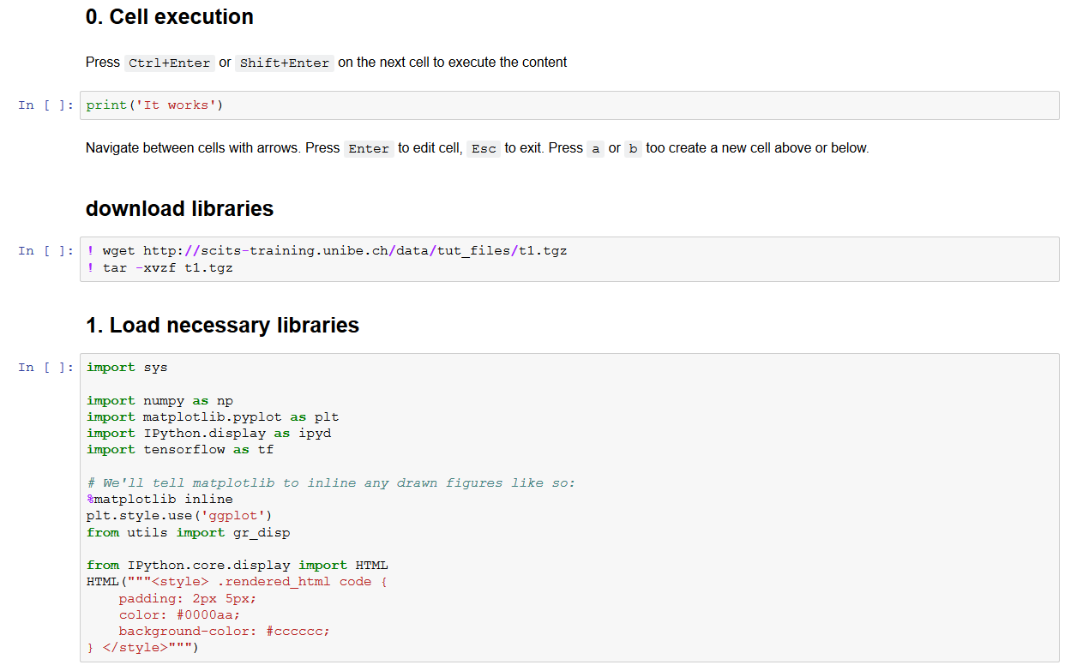
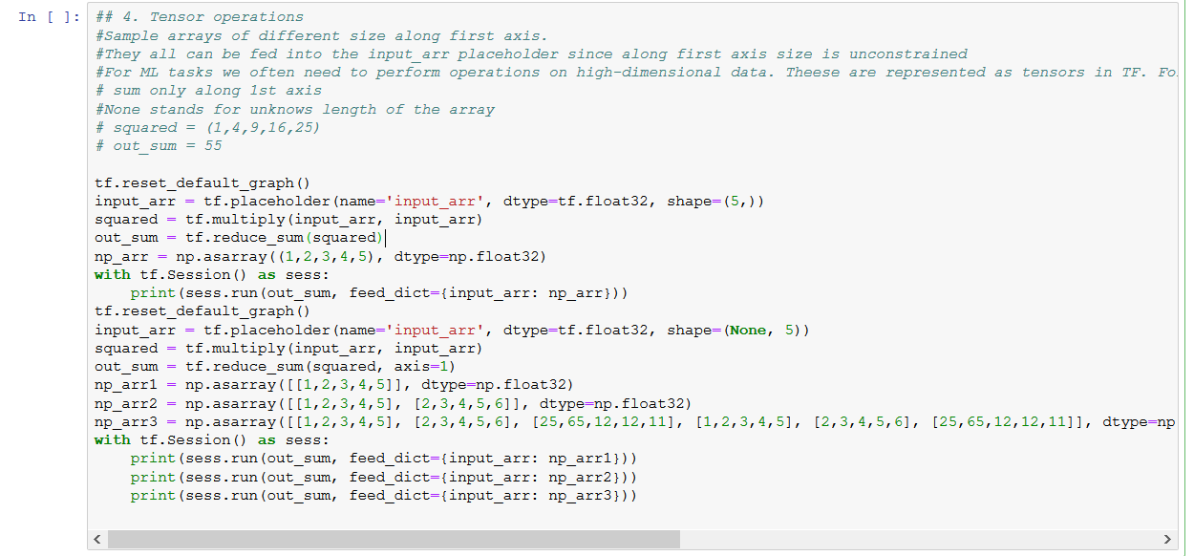
Refactor code in preference to explaining how it works
Do’s
If a code is very long, refactor it to multiple pieces and write the explanation at the beginning
Don’t’s
Writing big paragraph to explain one big and difficult chunk of code

Slide 4



Embed the documentation for a piece of software in that software
Do’s
Integrate documentation directly into code. To extract documentation, you can use knitr and Jupyter
Don’t’s
Write a word-document and put it on roughly the same location as the program

Slide 5
Discussion points
How detailed do you prefer a documentation to be?
Do you think comments on the implementation are bad?
Does it require different amounts of documentation depending on your expertise in programming?
How much of commenting can be averted by proper variable naming / use of functions?

